Slide 1
Lobachevsky State University of Nizhny Novgorod
Institute of Information Technology, Mathematics and Mechanics
Programming for AI-accelerators
Ascend Hardware and Ascend C Language Introduction
Arseniy Obolenskiy, Anton Gorshkov
anton.v.gorshkov@gmail.com

Slide 2
Contents
Ascend HW Architecture
Ascend C Language Introduction

Slide 3
Ascend HARDWARE ARCHITECTURE

Slide 4

Ascend Hardware: Overview
Da Vinci architecture
Each DaVinci Max AI Core features a 3D Cube Tensor Computing Engine (4096 FP16 MACs + 8192 INT8 MACs), Vector unit (2048bit INT8/FP16/FP32) and scalar unit. It includes a new AI framework called "MindSpore", a platform-as-a-service product called ModelArts, and a lower-level library called Compute Architecture for Neural Networks (CANN).
Ascend 310
The Ascend 310 is an AI inference SoC, it was codenamed Ascend-Mini. The Ascend 310 is capable of 16 TOPS@INT8 and 8 TOPS@FP16. The Ascend 310 features:
2x DaVinci Max AI cores
8x ARM Cortex-A55 CPU cores
8 MB on-chip buffer
16 channel video decode – H.264/H.265
1 channel video encode – H.264/H.265
TSMC 12 nm FFC process
8 W
Ascend 910
The Ascend 910 is an AI training SoC, it was codenamed Ascend-Max, which delivers 256 TFLOPS@FP16 and 512 TOPS@INT8. The Ascend 910 features:
32x Da Vinci Max AI cores arranged in 4 clusters
1024-bit NoC Mesh @ 2 GHz, with 128 GB/s bandwidth Read/Write per core
3x 240 Gbit/s HCCS ports for Numa connections
2x 100 Gbit/s RoCE interfaces for networking
4x HBM2E, 1.2 TB/s bandwidth
3D-SRAM stacked below AI SoC die
1228 mm² Total die size (456 mm² Virtuvian AI SoC, 168 mm² Nimbus V3 IO Die, 4x96 mm² HBM2E, 2x110 mm² Dummy Die)
32 MB on-chip buffer
128 channel video decode – H.264/H.265
TSMC 7+ nm EUV (N7+) process
350 W
The Ascend 910 Cluster has 1024–2048 Ascend 910 chips to reach 256–512 petaFLOPS@FP16. The Ascend 910 and Ascend Cluster will be available in Q2 2019.

Slide 5
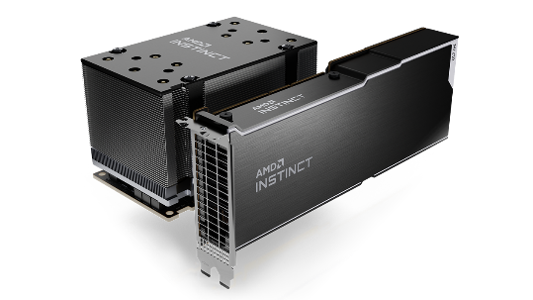
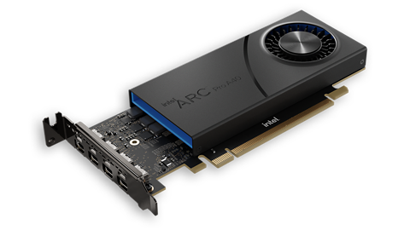
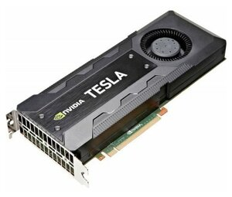
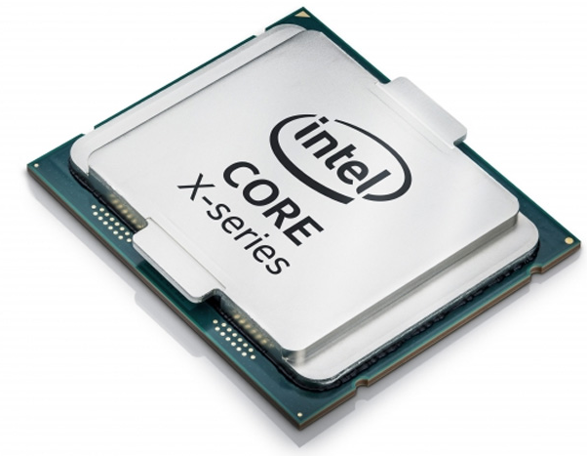
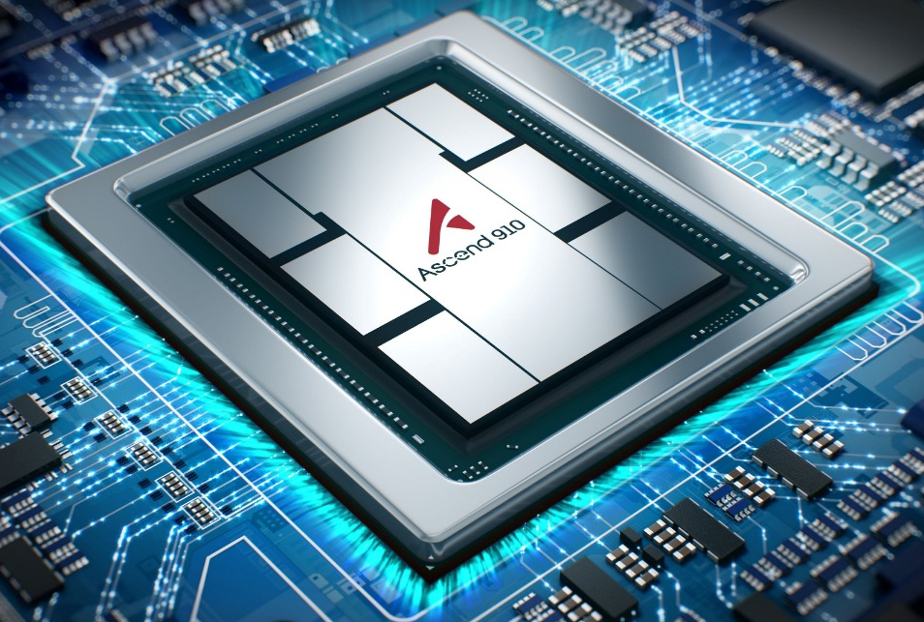
SIMT vs SIMD
SIMT
SIMD
NVIDIA GPU
AMD GPU
Intel CPU (SSE, AVX, …)
Intel ARC GPU
Huawei Ascend

Slide 6
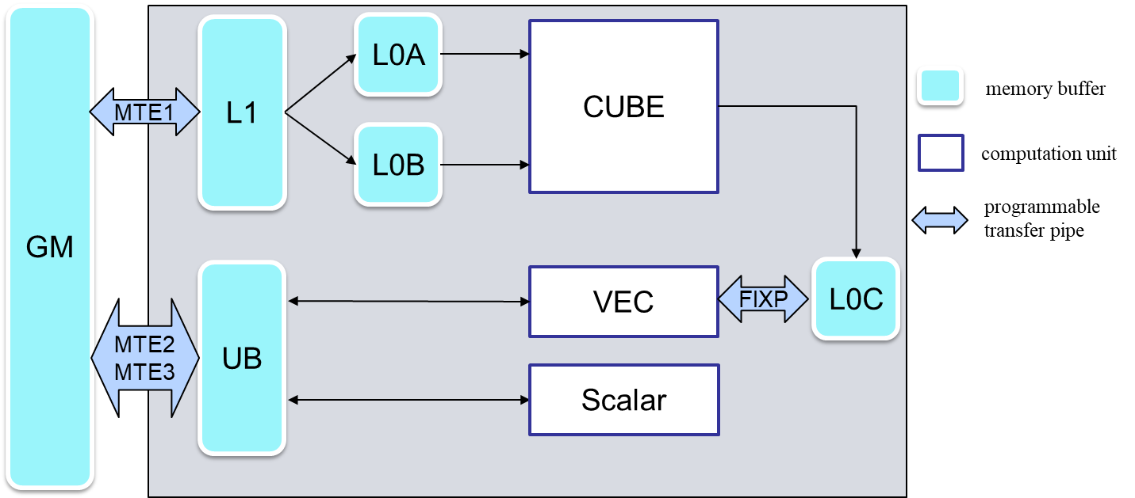
Ascend 910 Architecture Overview

Slide 7
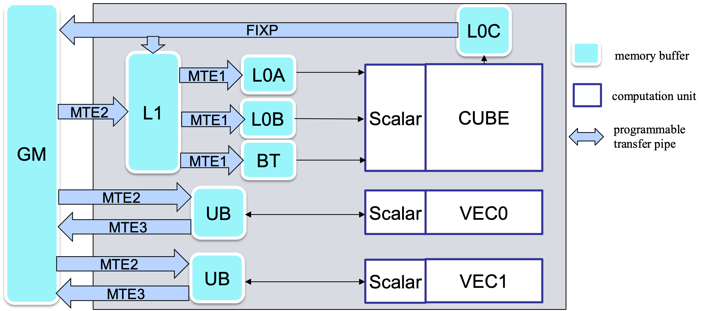
Ascend 910B Architecture Overview

Slide 8
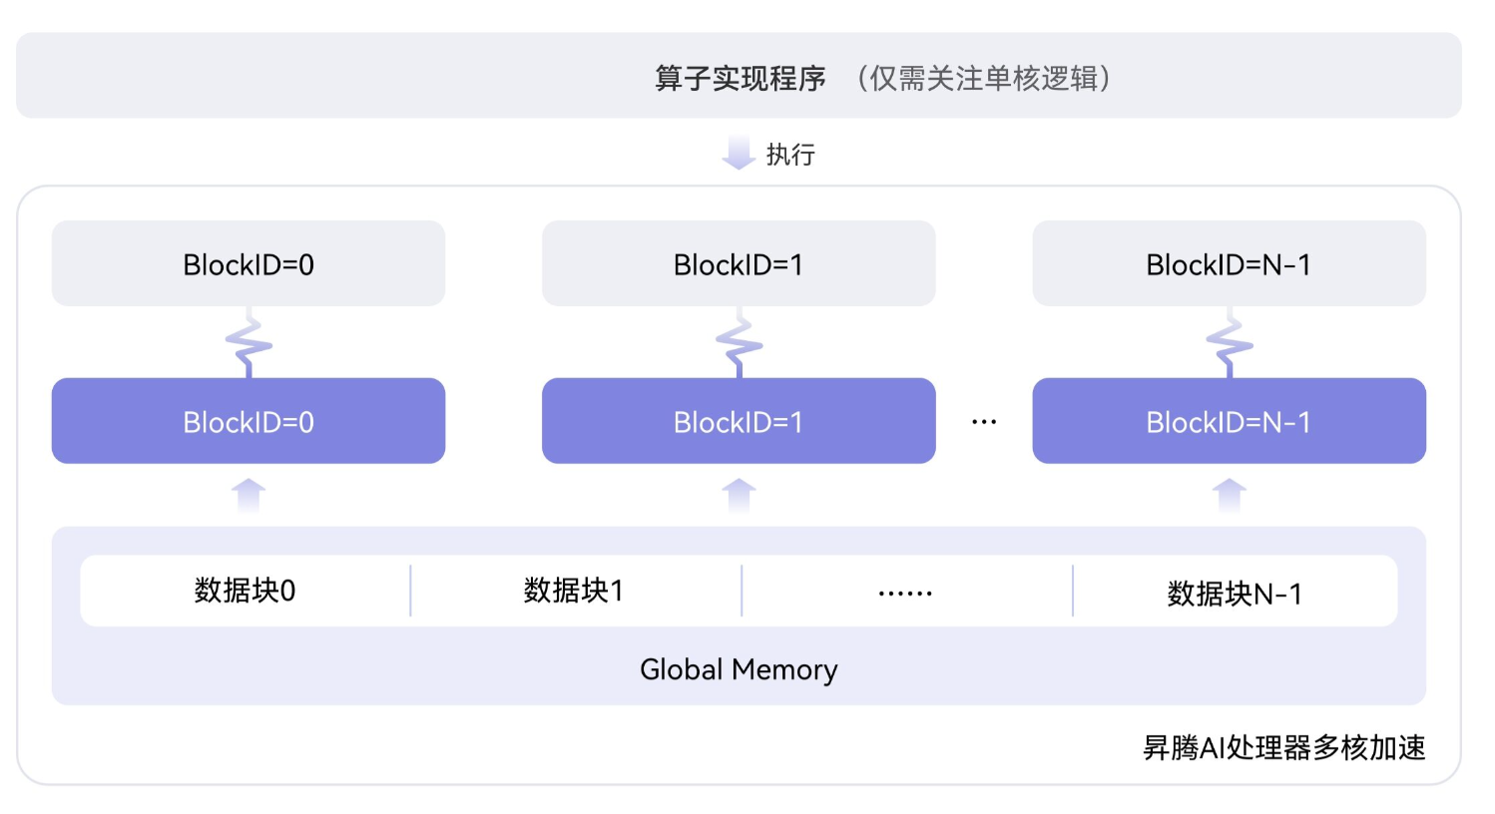
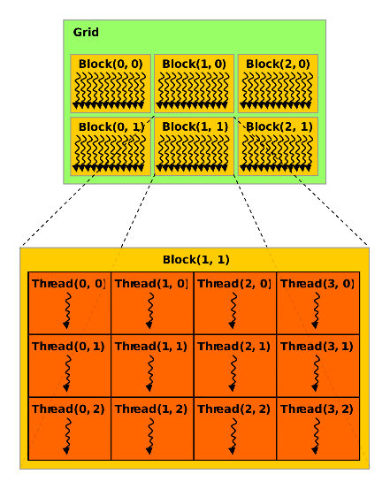
AICORE Level Parallelism
Parallelism is reached through:
SIMD vectors
Comparable with threads in NVIDIA CUDA
blockDim
AICORE level parallelism
Comparable with blocks in NVIDIA CUDA
gridDim
Huawei Ascend
NVIDIA GPU

Slide 9
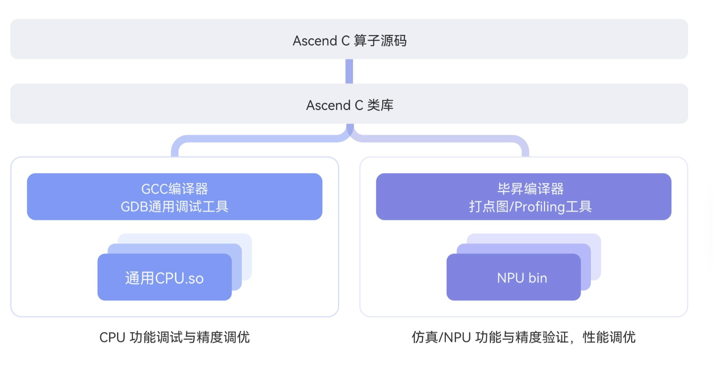
Debugging Capabilities
Ascend C can be compiled to:
NPU binary
Simulator and real device
x86/aarch64 CPU
Debugging can be done using different tools in each case:
CPU
gdb, npuchk, cceprint, …
Simulator
camodel (cycle accurate simulation) logs
Real device
msnpureport

Slide 10
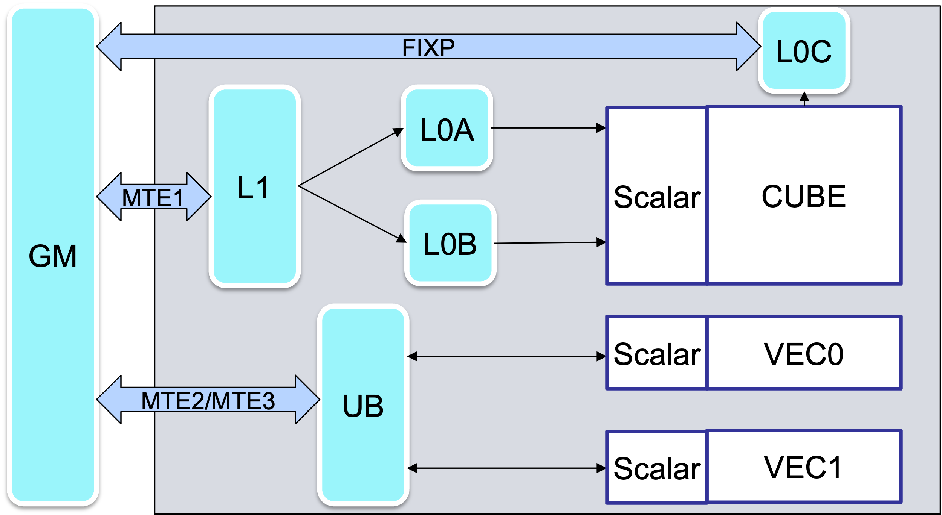
Ascend Programming Challenges
Sophisticated HW architecture: many programmable pipes, buffers, caches
Need for explicit data transfers and manual memory management
CUBE and VECTOR unit communications are organized through external memory, it impacts mixed kernels implementation
CUBE pipeline
VEC pipeline

Slide 11
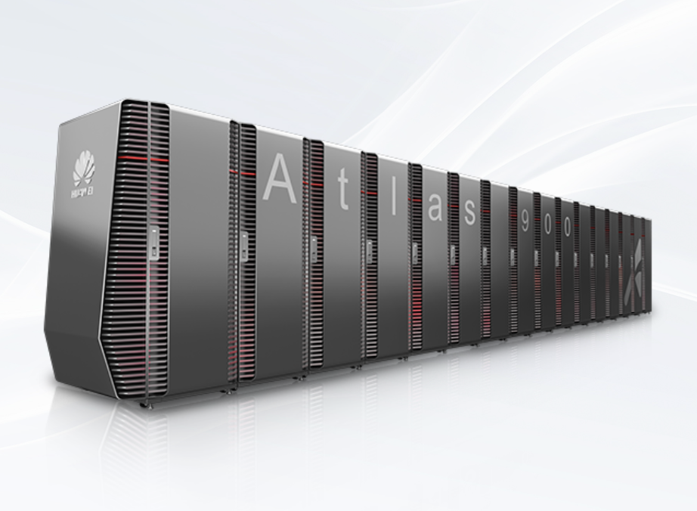
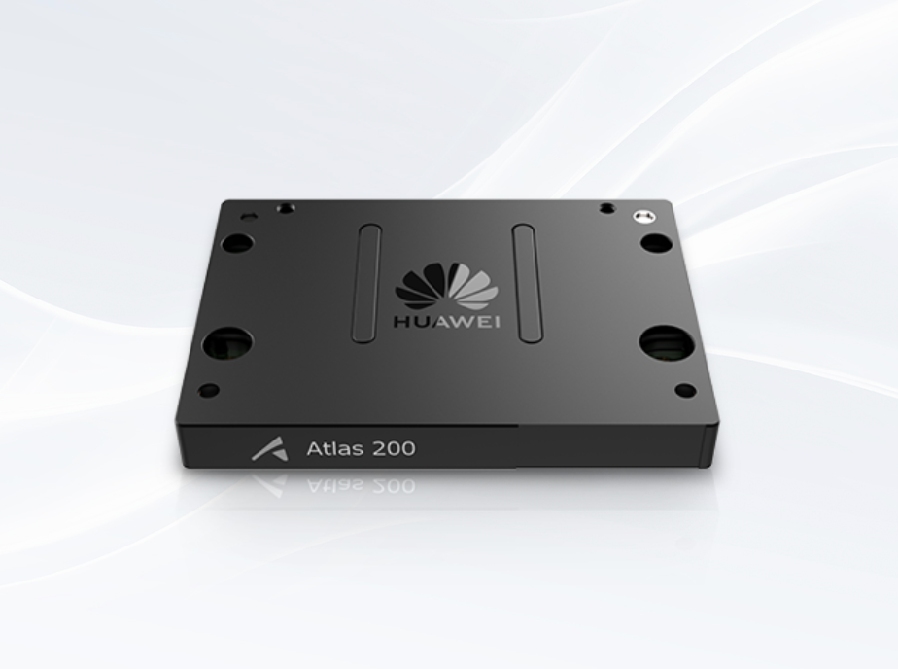
Ascend HW: Usage Scenarios
Training
Inference
The Atlas 900 AI cluster consists of thousands of Ascend processors.
The Atlas 200 AI accelerator module (model: 3000) integrates the Ascend processor to implement image recognition and image classification on the device side. Atlas 200 is widely used in AI scenarios such as intelligent cameras, robots, and drones.
Product Line: https://e.huawei.com/en/products/computing/ascend

Slide 12




Products That Support Ascend
Huawei CANN https://www.hiascend.com/en/software/cann
MindSpore https://gitee.com/mindspore/mindspore
OpenCV https://github.com/opencv/opencv/wiki/Huawei-CANN-Backend
OpenMMLab Detection Toolbox and Benchmark https://github.com/open-mmlab/mmdetection

Slide 13


Programmability: Kernel (Operator) Level
Which programming interfaces are available for kernel developers?
TBE DSL
Python API that exposes domain-specific language (DSL) for simple programming
Easier to use but may be slow
Currently deprecated
TBE TIK
Python API that is suitable for low-level development with some enhancements
Currently deprecated
CCE-C
Suitable for low-level programming, intrinsic-based
Poorly documented
Not supposed to be used by end users
Ascend C Language
Suggested for using by Huawei

Slide 14


Programmability: Network Level
CANN stack supports integration to the following ML/DL frameworks
PyTorch kernels integration
https://gitee.com/ascend/torch
ONNX
https://github.com/microsoft/onnxruntime/tree/main/onnxruntime/core/providers/cann
MindSpore
https://gitee.com/mindspore/mindspore

Slide 15
Ascend C language

Slide 16
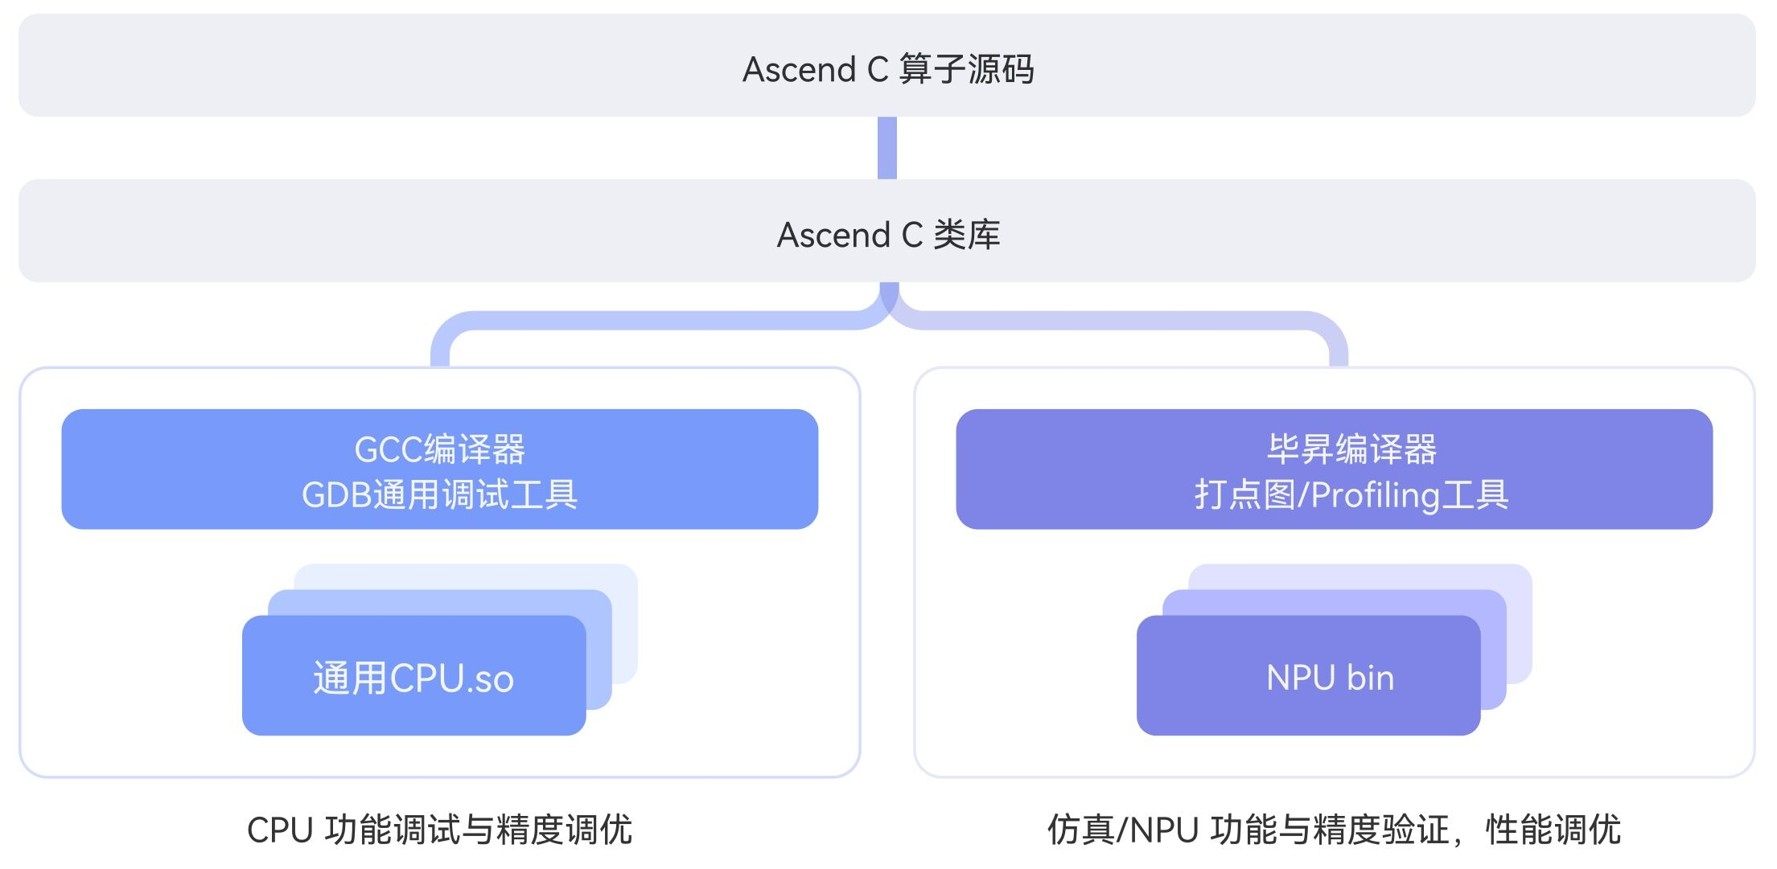
Ascend C: Documentation
Website: https://www.hiascend.com/ascend-c (中文)
Detailed Programming Guide: https://www.hiascend.com/document/detail/zh/CANNCommunityEdition/80RC1alpha001/devguide/opdevg/ascendcopdevg/atlas_ascendc_10_0001.html (中文)

Slide 17
Host and device code
Host code and device code
Host code: code that runs on the CPU. It typically includes setup, data preparation, launching GPU/NPU kernels, and handling the results returned from the GPU/NPU.
Device code: This is the code that runs on the GPU/NPU. Device code operates on data stored in device memory and is executed by many threads in parallel.
Host/device code split implementation in Ascend C
Similarities with CUDA
NPU kernel invocation logic is the same
Difference
API for NPU invocations has differences with CUDA one
In addition, there is a separate CPU debug mode that allowas to execute code on CPU instead of NPU that uses differerent code invocation API
int main()
{
...
// Kernel invocation with N threads
VecAdd<<<1, N>>>(A, B, C);
...
}

Slide 18
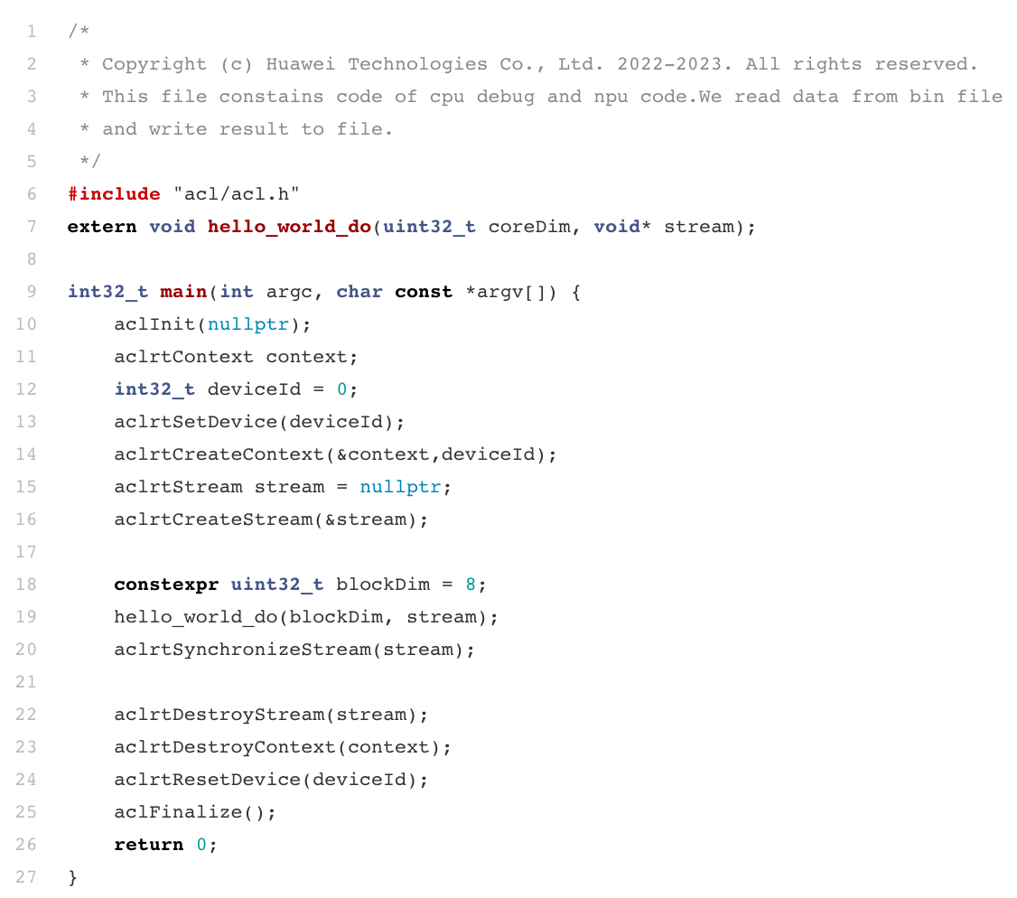
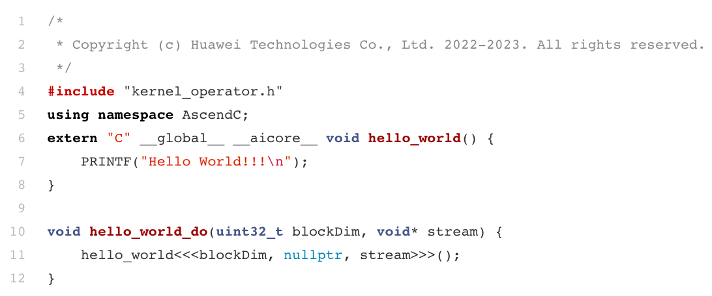
Ascend C By Example: HelloWorld
Example that prints “Hello World”
main.cpp
hello_world.cpp
ACL* Runtime (RT) API header file
ACL context initialization
Device side operator library (Ascend C API)
Ascend device selection
Device side printf-like function
Kernel invocation
ACL context de-initialization (finalization)
* ACL – Ascend Compute Library
Source code: https://gitee.com/ascend/samples/tree/master/operator/HelloWorldSample

Slide 19
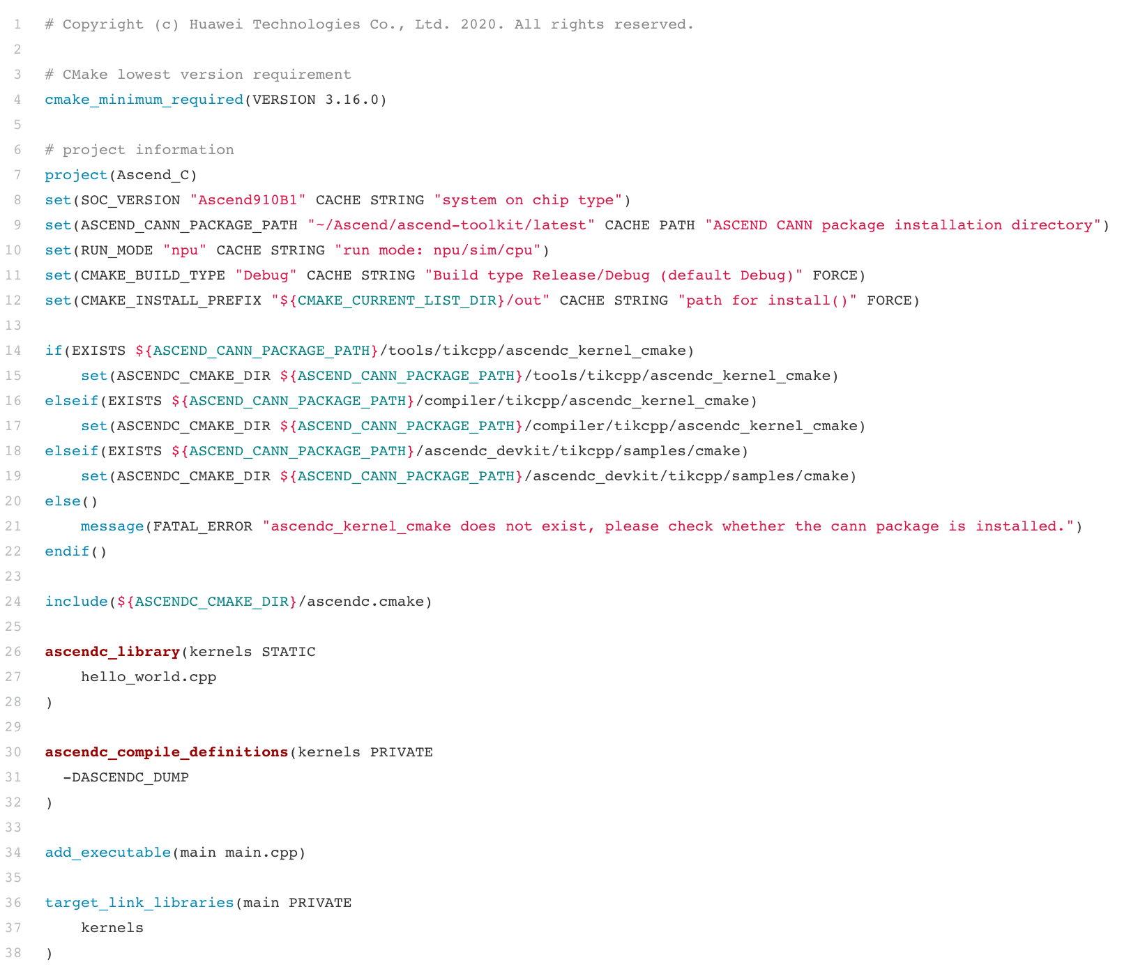
Ascend C By Example: build & run
CMakeLists.txt
https://gitee.com/ascend/samples/blob/master/operator/ascendc/0_introduction/3_add_kernellaunch/AddKernelInvocationNeo/CMakeLists.txt
Build & run
Select Ascend device chip version
Set path to Huawei CANN software stack installation
rm -rf build
mkdir build
cmake -B build
cmake --build build -j
cmake --install build
./build/main
Choose execution mode:
- Hardware
- Simulator
- CPU debug
Reuse pre-defined templates for kernel development supplied with CANN stack
Create kernels library
Provide compiler options for kernels library
Build host side executable that invokes kernels from operators library

Slide 20
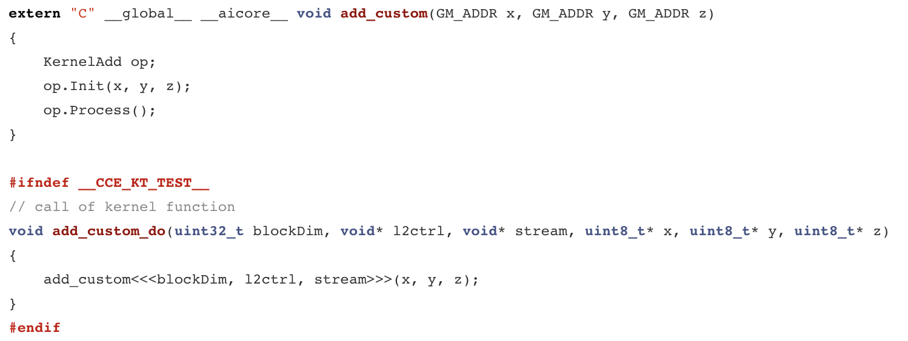
Ascend C By Example: Vector Add
Device code:
https://gitee.com/ascend/samples/blob/master/operator/ascendc/0_introduction/3_add_kernellaunch/AddKernelInvocationNeo/add_custom.cpp
Host code:
https://gitee.com/ascend/samples/blob/master/operator/ascendc/0_introduction/3_add_kernellaunch/AddKernelInvocationNeo/main.cpp
Kernel function attribute : __global__
Device function attribute: __aicore__
Macro that is defined for CPU run: __CCE_KT_TEST__
Kernel invocation on the host code: <<< >>>

Slide 21
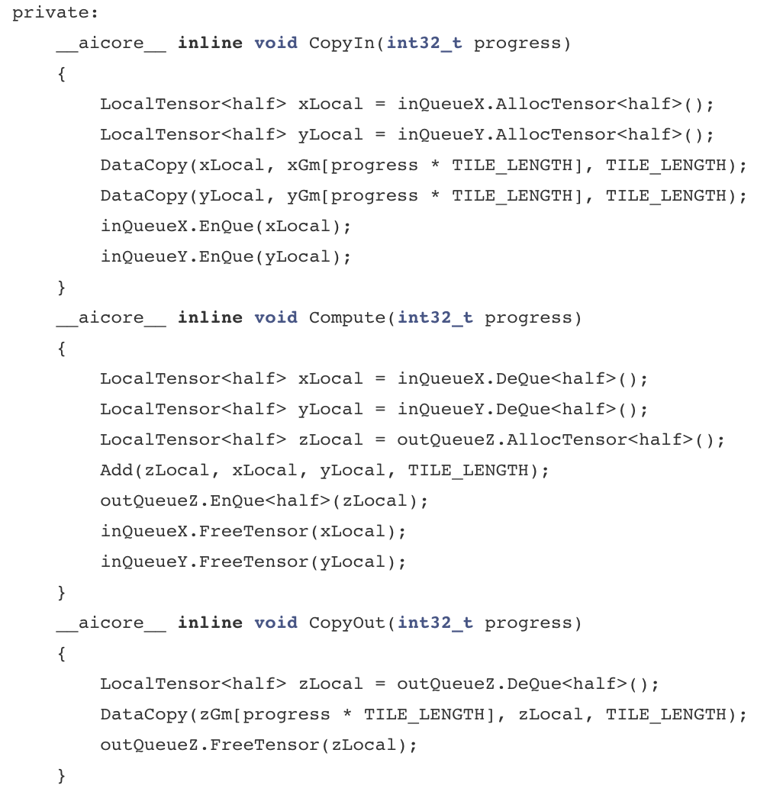
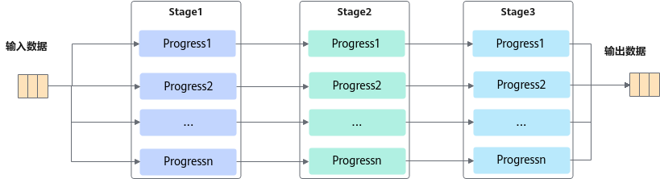
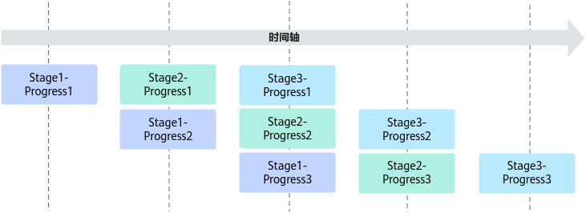
Ascend C By Example: Vector Add (Pipeline Paradigm)
Device execution pipeline is split into 3 steps:
CopyIn, Compute, CopyOut

Slide 22

Running Ascend C Kernels
Instructions:
https://gitee.com/ascend/samples/tree/master/operator/ascendc/0_introduction/3_add_kernellaunch/AddKernelInvocationNeo
Covered and available run scenarios:
CPU
NPU simulator
NPU on-board
Dependences:
CANN
EE: https://support.huawei.com/enterprise/en/ascend-computing/cann-pid-251168373/software/
CE: https://www.hiascend.com/zh/developer/download/community/result?module=cann

Slide 23
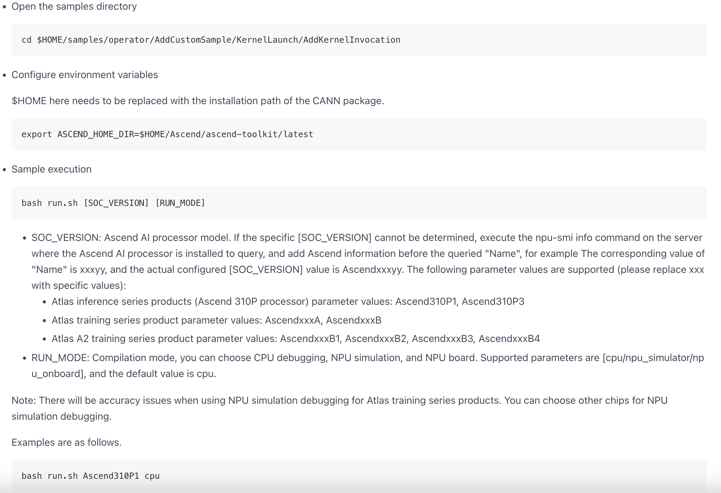

Running Ascend C Kernels: Step-by-Step Guide

Slide 24
Next Time
Ascend C Programming Details
Matrix Multiplication Kernel
Mixed Kernels

Slide 25
References
Ascend C: https://www.hiascend.com/ascend-c
Ascend C Samples: https://gitee.com/ascend/samples/
Ascend C Programming Guide: https://www.hiascend.com/document/detail/zh/CANNCommunityEdition/80RC1alpha001/devguide/opdevg/ascendcopdevg/atlas_ascendc_10_0001.html
Huawei CANN Community Edition: https://www.hiascend.com/zh/developer/download/community/result?module=cann
Ascend Computing: https://e.huawei.com/en/products/computing/ascend/
TBE DSL: https://www.hiascend.com/document/detail/en/CANNCommunityEdition/600alphaX/opdevg/opdevg/atlaste_07_0001.html
TBE TIK: https://www.hiascend.com/document/detail/en/CANNCommunityEdition/600alphaX/opdevg/opdevg/atlastikapi_07_0001.html

Slide 26
Team
Anton Gorshkov, Ph.D., Associate Professor at Lobachevsky State University, Principal Engineer at Huawei
Arseniy Obolenskiy, Senior Engineer at Huawei
Mikhail Lychkov, Senior Engineer at Huawei
Oleg Maslov, Ph.D., Expert at Huawei

